Slide 1

Retail Finance Analytics MVP — Architecture & Flow

Slide 2
Objective of MVP
Deliver a minimal but functional ETL pipeline that:
01
02
03
Ingests raw sales order data from source system(s).
Cleanses and enriches the data (removing duplicates, standardizing formats).
Loads structured data into a Data Warehouse for reporting.
04
Produces cleansed data for products, customers, and geography.

Slide 3
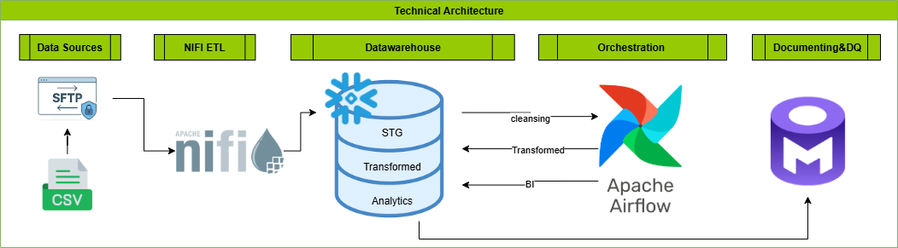
Technical Architecture

Slide 4
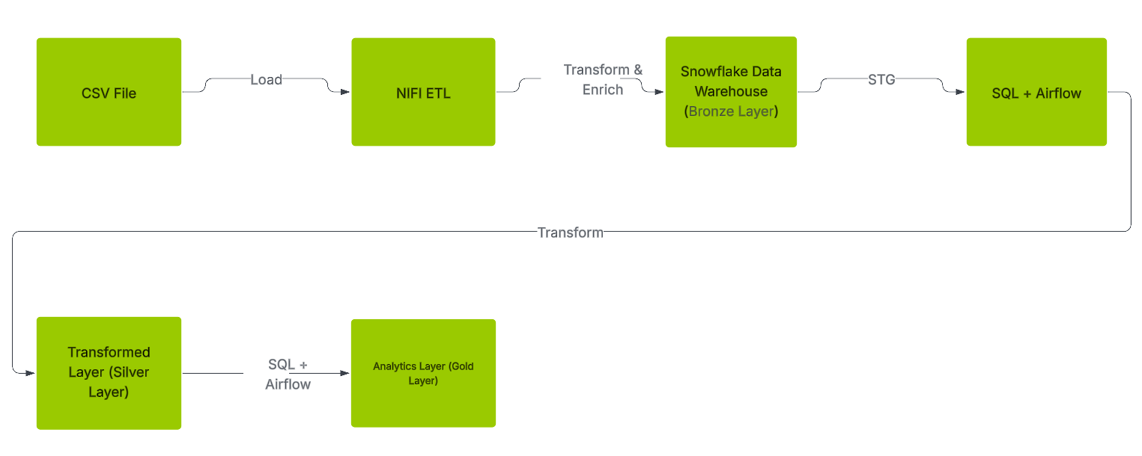
Data Processing Flow

Slide 5
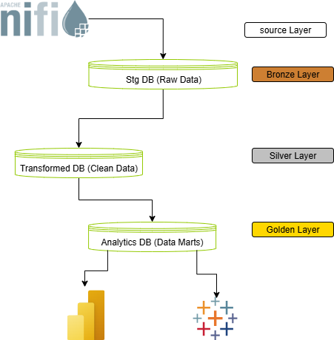
Structure of DWH

Slide 6


Data Pipeline Automation
NiFi Automation Flow
ListFile scans input folder every 10 sec for new CSVs.
UpdateAttribute adds metadata (file_name, tbl_dt, ingested_at).
CSVReader + UpdateRecord parse and standardize records.
PutDatabaseRecord inserts data into Snowflake STG.
Airflow Automation Flow
Monthly trigger
Transformed load → run queries that do the cleansing of data for both dimensions and fact table.
Re-run safe → using merge sql statement

Slide 7
Inconsistency Analysis
Inconsistency Type | Description | Suggestion to handle
Duplicate ROWID | Same ROWID appears in multiple loads because corrected files were re-pushed; | the valid record is the one with the most recent TBL_DT (derived from the file name date like 2019_02_01 → 20190201).
Inconsistent date formats | ORDERDATE come in mixed formats (/, -, etc.); | they must be standardized and stored as real dates with canonical YYYY-MM-DD and hyphens only.
Garbled symbols in text columns | String fields contain mojibake/special characters (e.g., Memo Book, ... 5 3/8� x 11� | requiring character encoding normalization/cleaning across all string columns.
Positive PROFIT with QUANTITY = 0 | Invalid business state; only the case negative profit with quantity = 0 (returns/adjustments) is acceptable | positive profit with zero quantity must be flagged.
SUBCATEGORY always NULL | Dimension attribute not populated at all (systematically missing) | indicating an upstream mapping or enrichment gap.

Slide 8
Success Criteria
Automation
Completeness
Traceability
Pipeline runs ever as schedule without manual intervention.
All files from sources are ingested into Snowflake STG.
Each record carries metadata
Monitoring & Alerts
Data Quality
On pipeline failure, the required team receives an alert notification
Apply solid quality rules using data management tool

Slide 9


